Slide 1
Department of Computer Science & Engineering
A Mini Project Presentation
on
MACHINE LEARNING DEPLOYMENT IN AWS SAGEMAKER
Batch No: D11
B. Ravi Kumar (228R1A05L1)
K. Kavitha (228R1A05N0)
K. Sai Saanvi (228R1A05N4)
N. Eswari (228R1A05P9)
K. Akhil Yadav (238R5A0528)
Internal Guide
Ms. Sai Manasa,
Assistant Professor,
Dept. of CSE.

Slide 2
CONTENTS
Abstract
Introduction
Literature Survey
Existing System and Limitations
Proposed System and Advantages
Software Requirements
Hardware Requirements
Tools and Technologies used
UML Diagrams(use case, sequence, etc)
System Architecture
System Testing
Output Screens
Conclusion
Future Enhancements
References

Slide 3
ABSTRACT
We present a smart traffic management system to detect and count vehicles from real-time images using the YOLOv8 object detection model.
The primary goal is to deploy this machine learning model on Amazon SageMaker to ensure scalable, efficient, and cloud-based inference capabilities.
Our system accepts traffic images as input, detects and classifies vehicles into categories such as cars, motorcycles, buses, and trucks, and calculates an adaptive green signal time based on traffic density.
The trained YOLOv8 model is packaged and deployed using SageMaker's custom model deployment features.

Slide 4
INTRODUCTION
Traffic congestion is a major issue in urban areas, leading to delays, fuel wastage, and increased pollution.
Traditional traffic lights follow fixed timers, which do not adapt to real-time traffic conditions.
This project proposes a smart traffic system that detects vehicles using YOLOv8 (You Only Look Once) and adjusts green light duration dynamically.
The system leverages Amazon SageMaker to deploy the ML model for scalable and real-time inference.

Slide 5
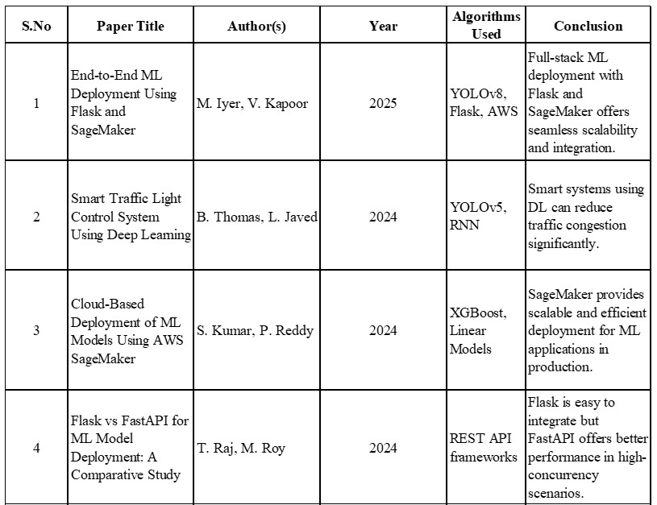
LITERATURE SURVEY

Slide 6
EXISTING SYSTEMS
Fixed Time Signal Systems -
Operate traffic lights based on pre-set timers.
Cannot adapt to real-time traffic flow, causing unnecessary delays and congestion.
Manual Traffic Control -
Traffic police manage signals based on human judgment.
Prone to human error, inconsistent, and not scalable for large cities.
Traditional Image Processing Technique -
Use basic motion detection and background subtraction.
Struggle with accuracy in poor lighting, occlusions, or complex traffic scenarios.

Slide 7
LIMITATIONS
Inefficient during peak and off-peak hours.
Requires constant manpower and lacks scalability.
Not scalable for city-wide implementation.
Requires constant manpower and lacks scalability.
Cannot adapt to real-time traffic changes or emergencies.

Slide 8
PROPOSED SYSTEM
Real-Time Vehicle Detection
Uses YOLOv8 to detect and classify vehicles from traffic images quickly and accurately
Smart Signal Timing
Calculates dynamic green light duration based on the number of detected vehicles.
AWS SageMaker Integration
ML model is deployed using SageMaker for scalable and reliable inference.
Support for Multiple Vehicle Types
Recognizes cars, buses, trucks, and motorcycles using COCO class IDs.

Slide 9
ADVANTAGES
Dynamic Traffic Management: Adjusts signal timings in real-time based on actual traffic conditions, reducing congestion.
Improved Traffic Flow: Optimizes green light duration to minimize waiting times and prevent traffic jams.
Cost-Effective: Eliminates the need for expensive physical sensors or infrastructure upgrades.
Scalable and Flexible: Cloud deployment on AWS SageMaker allows easy scaling and updates without hardware changes.

Slide 10
SOFTWARE REQUIREMENTS
Operating System Windows / Linux / macOS
Python Version Python 3.8 or higher
Libraries ultralytics, opencv-python, flask, etc.
Cloud Platform AWS Free Tier (SageMaker, EC2)
Browser Chrome / Firefox / Edge (for AWS UI)

Slide 11
HARDWARE REQUIREMENTS
Processor Dual Core / i3 / i5 / i7
RAM 4 GB (Minimum)
Hard Disk 100 GB or above
Internet Stable connection (for accessing AWS services)

Slide 12
TOOLS AND TECHNOLOGIES USED
Programming Language
Python : Used for backend logic, ML model integration, and image processing.
Machine Learning
YOLOv8 (You Only Look Once) : Pre-trained object detection model for detecting cars, trucks, buses, etc.
Cloud Services
Amazon SageMaker : For ML model deployment and inference
Amazon EC2 : For full-stack deployment (Flask + frontend)

Slide 13
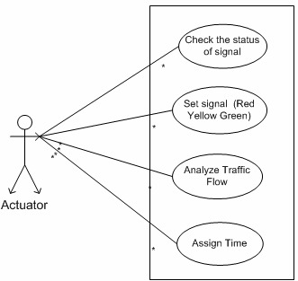
USE CASE DIAGRAM

Slide 14
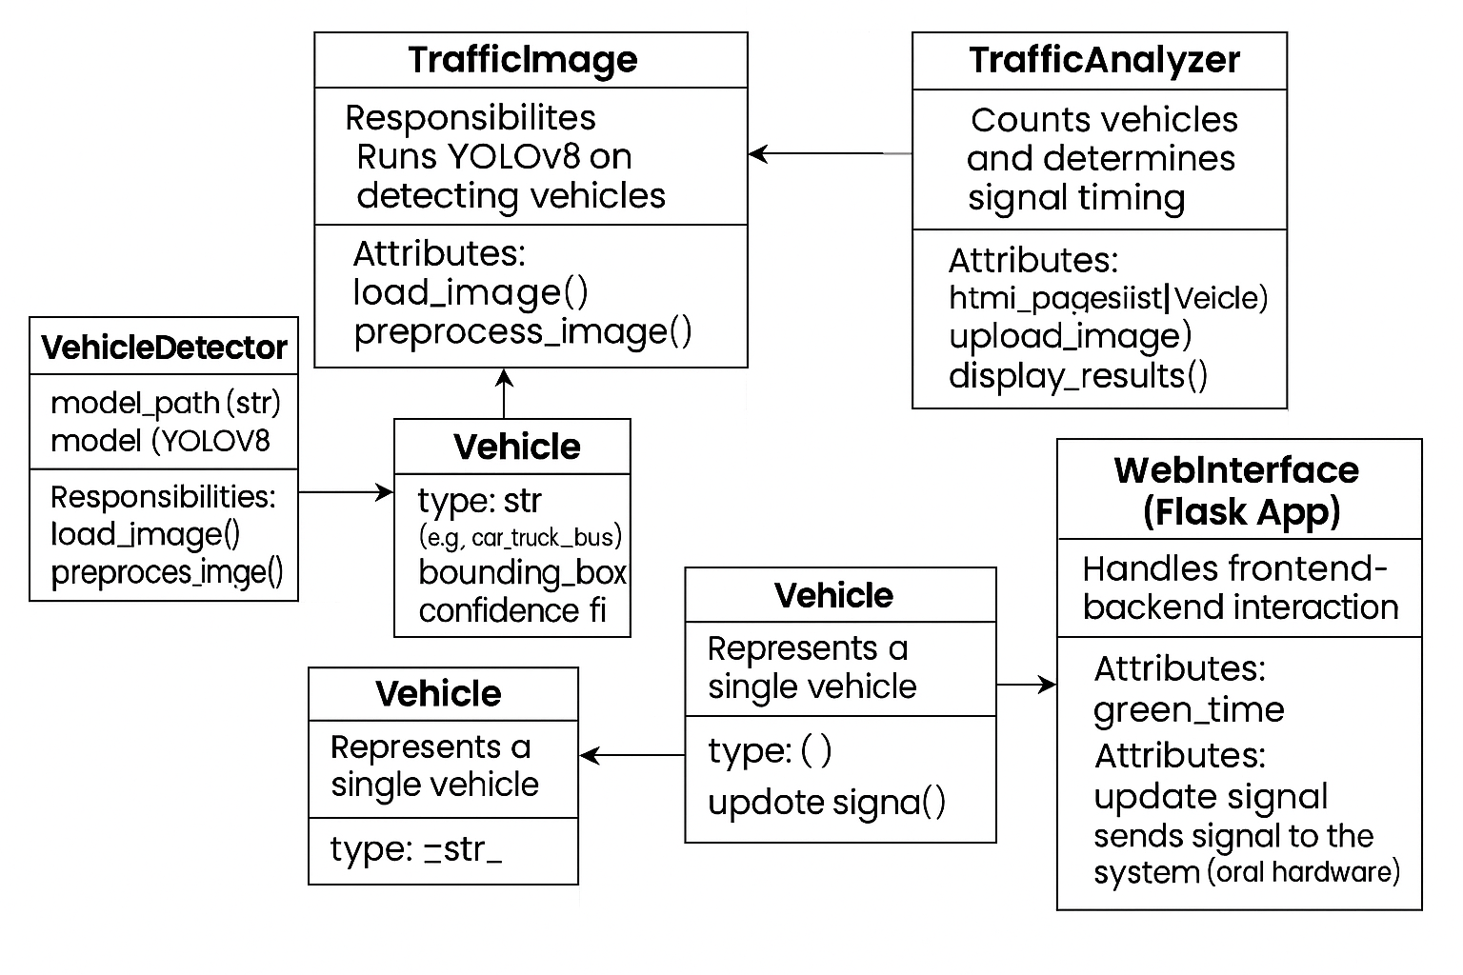
CLASS DIAGRAM

Slide 15
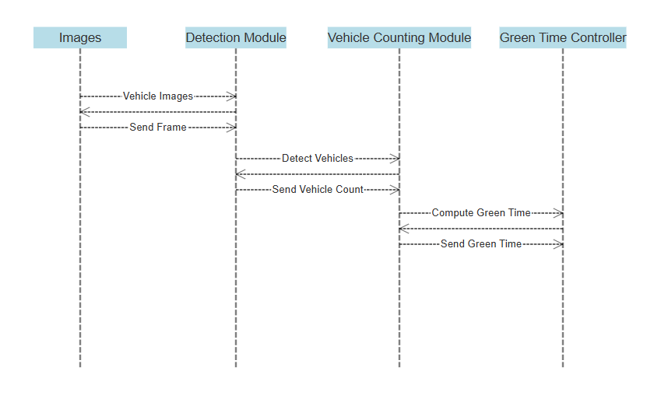
SEQUENCE DIAGRAM

Slide 16
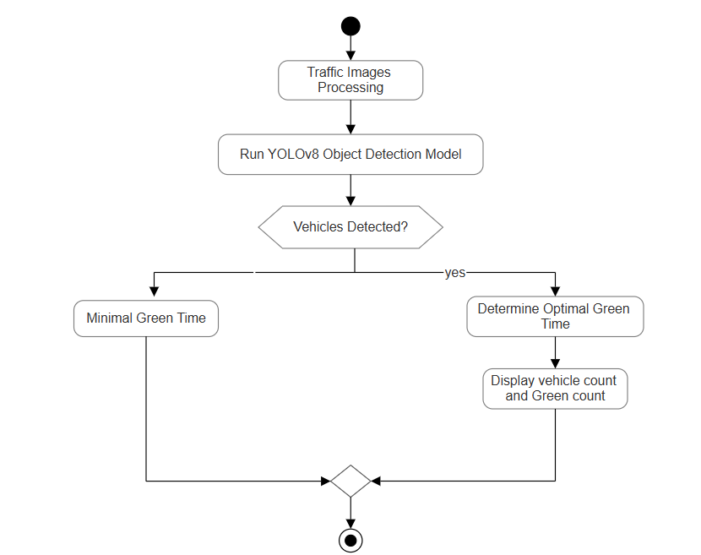
ACTIVITY DIAGRAM

Slide 17
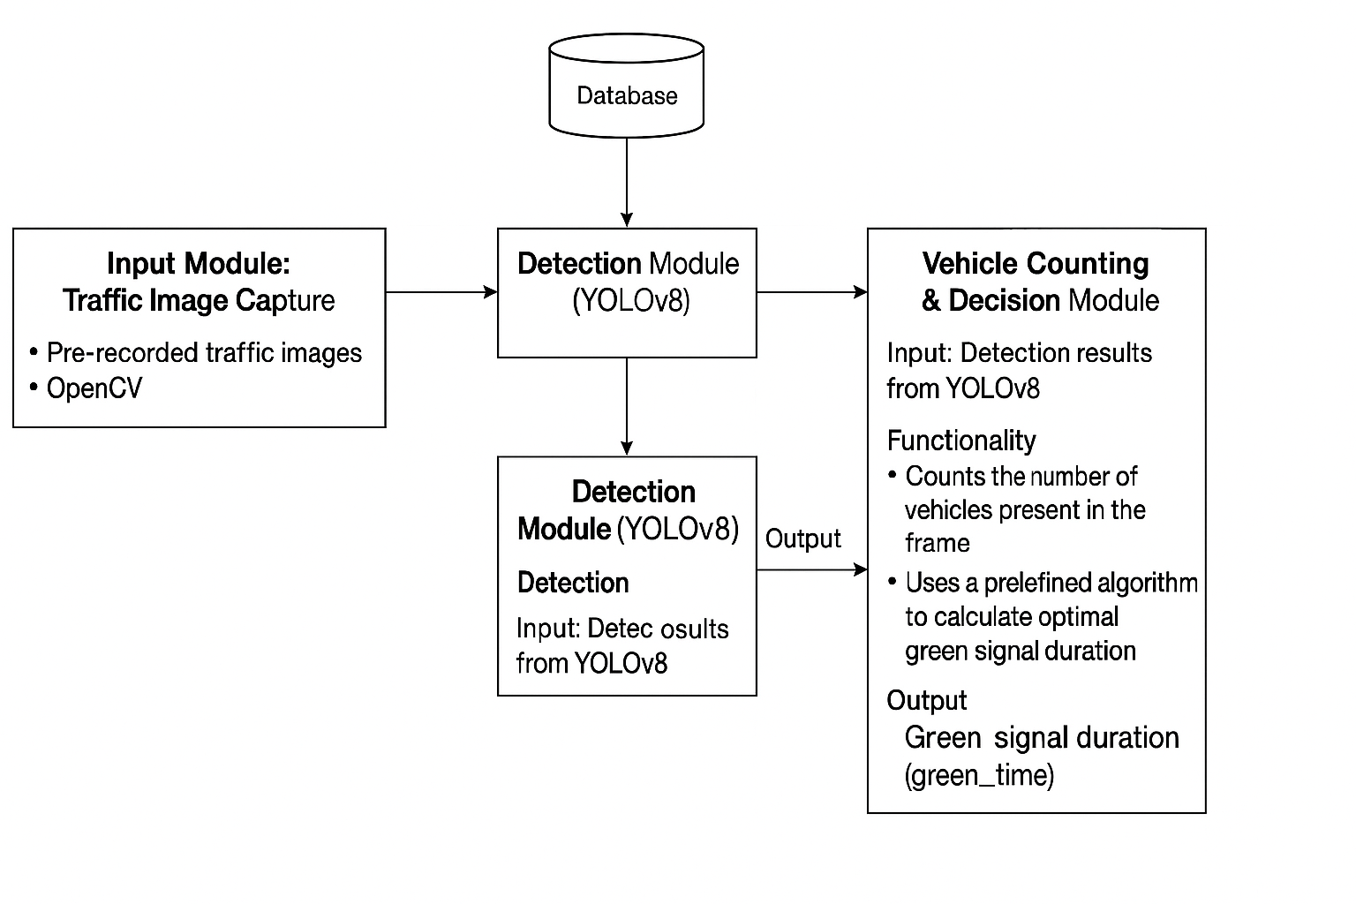
SYSTEM ARCHITECTURE

Slide 18
SYSTEM TESTING
Functional Testing: Verify real-time detection of vehicles and ambulances.
Integration Testing: Confirm compatibility between Flask backend and SageMaker deployment.
Performance Testing: Stress test the system with high traffic volume to observe stability.
Security Testing: Verify secure API endpoints and protection from unauthorized access.
Usability Testing: Assess frontend interface for clarity and ease of use.

Slide 19
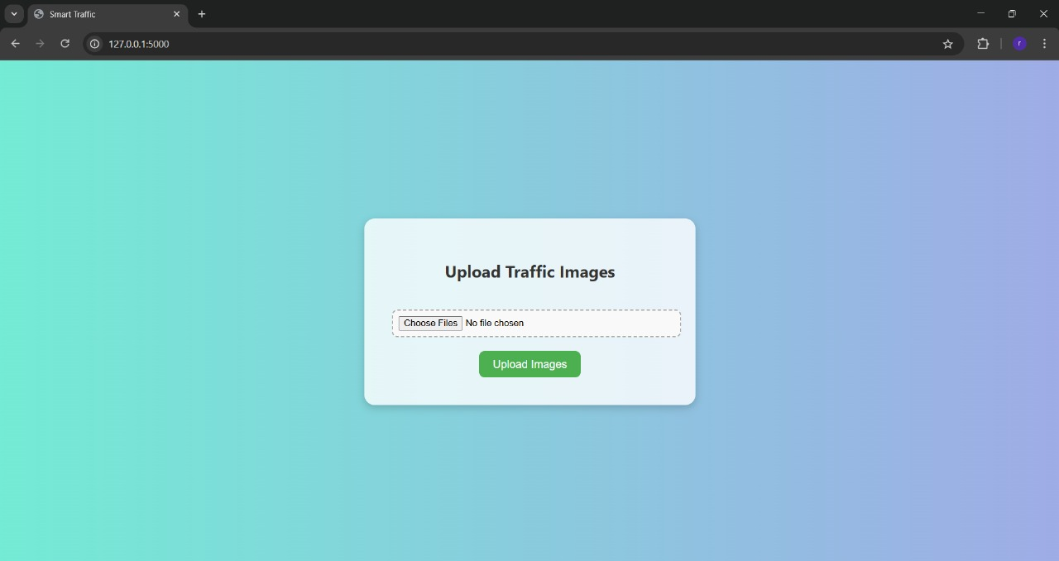
OUTPUT SCREENS
Fig (a) : Main Page

Slide 20
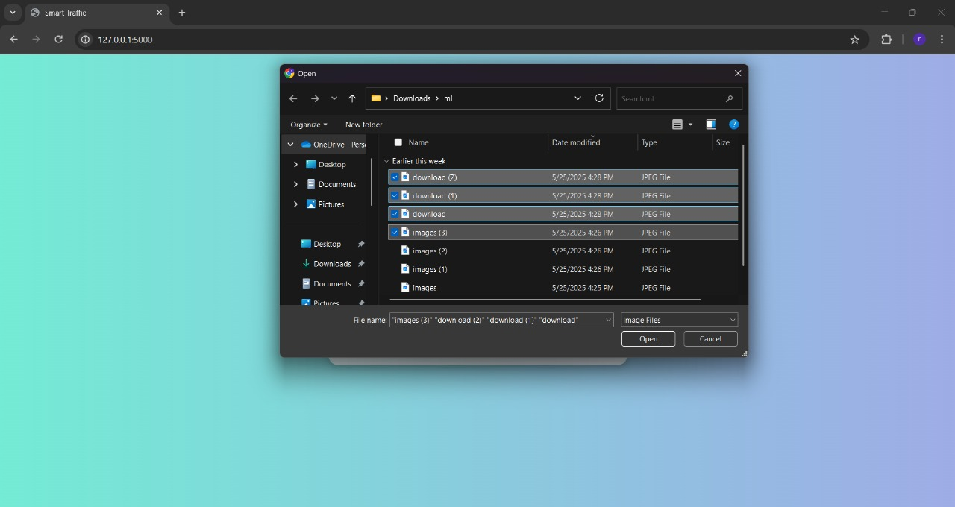
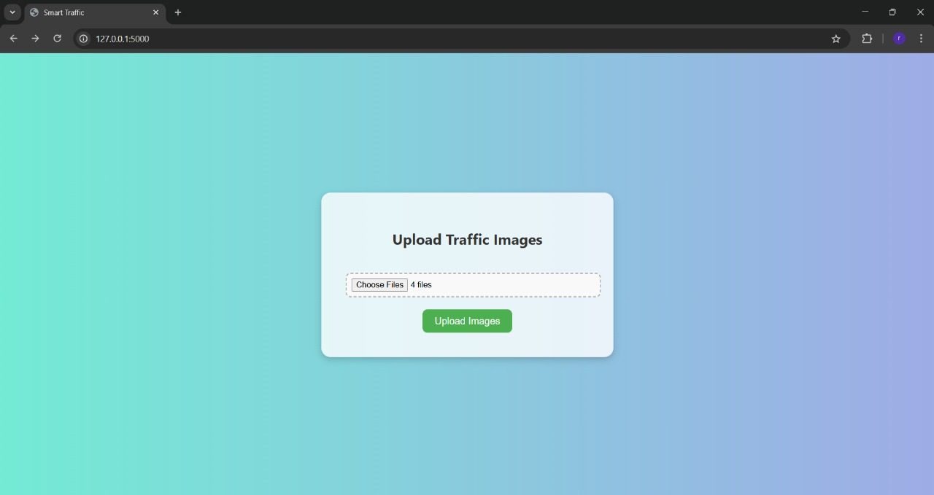
Fig (b) : Selection of Images

Slide 21
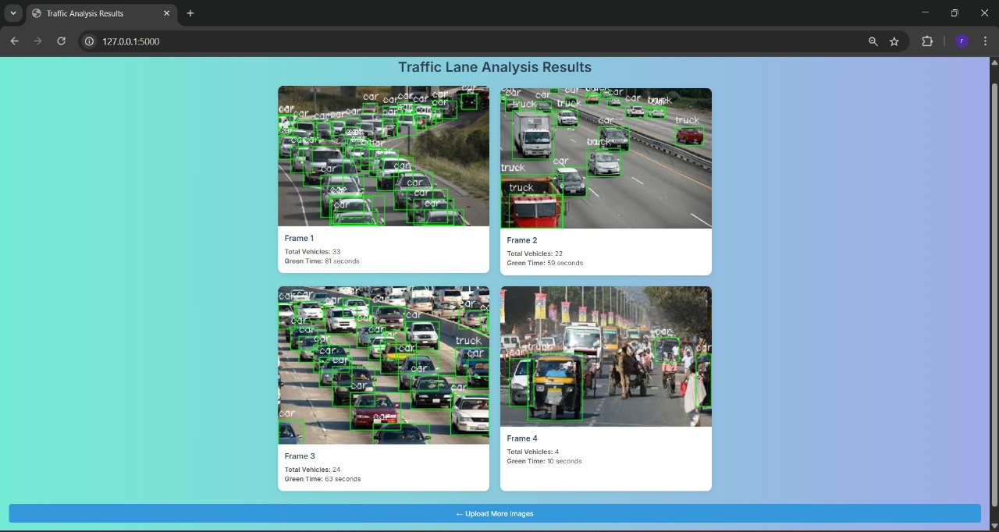
Fig (d) : Result page

Slide 22
CONCLUSION
The Smart Traffic System developed in this project provides a practical and efficient solution for real-time traffic management using computer vision and machine learning.
The system leverages the YOLOv8 object detection model to identify and count various types of vehicles in traffic footage.
By analysing the density of vehicles, it can make informed decisions to optimize traffic signal timings dynamically, thus contributing to smoother traffic flow and reduced congestion.
Deployed using AWS SageMaker, the system benefits from cloud scalability, fast inference, and seamless integration with other AWS services.

Slide 23
FUTURE ENHANCEMENTS
Ambulance Detection and Priority Handling: The system can be enhanced to identify emergency vehicles like ambulances in real-time.
Accident Detection System: accident detection capabilities can be included to identify collisions based on motion anomalies or object displacement, triggering immediate emergency response protocols.
Weather and Lighting Adaptation: To ensure accuracy during night time, rain, etc the system can be upgraded to use infrared cameras alongside standard video feeds.
Multi-Camera Integration: To scale the solution beyond a single intersection, the system can be extended to support multiple camera feeds from various junctions across a city.

Slide 24
REFERENCES
[1] J. Redmon, S. Divvala, R. Girshick, and A. Farhadi, “You Only Look Once: Unified, Real-Time Object Detection,” Proc. IEEE Conf. Computer Vision and Pattern Recognition. 2016. https://doi.org/10.1109/CVPR.2016.91
[2] A. Bochkovskiy, C.-Y. Wang, and H.-Y. M. Liao, “YOLOv4: Optimal Speed and Accuracy of Object Detection,” .2020. https://arxiv.org/abs/2004.10934
[3] M. Abadi et al., “TensorFlow: Large-Scale Machine Learning on Heterogeneous Distributed Systems,” 2016. https://arxiv.org/abs/1603.04467
[4] Himanshu Singh, “Practical Machine Learning with AWS: Process, Build, Deploy, and Productionize Your Models Using AWS”. 2021. https://www.amazon.com/Practical-Machine-Learning-AWS-Productionize/dp/1484262212

Slide 25
THANK YOU

